Slide 1
Cost of Living 2026
Presented by Kristina Stipetic, Research Analyst
Notes:
This is a preview of our key findings. More will follow in the main report. Today we just wanted to test these findings with you.

Slide 2
About this project
What is the Cost of Living Index?
An index based on five different indicators – fuel poverty, child poverty, claimant count, economic inactivity and low pay.
Continuation of a project started in 2022 by the Centre for Progressive Policy
Why repeat the Index now?
What was originally termed a “crisis” is a long-term structural challenge
Uses of the Cost of Living Index
Identify places which are vulnerable to the Cost of Living
Help identify priorities within regions or Combined Authorities
Identify patterns in types of vulnerability
Notes:
Why now? The problems continue, been talked about more in recent months.
Sustained pressure on utilities / bills like energy and water
No overall progress on poverty in last decade and increase in families with children in poverty since 2020 (see JRF)
Food prices continue to rise beyond target 2% - annual food price inflation 4.5% to dec 25
Very low growth in disposable incomes expected over next few years - see IFS
Wider sense of discontent - people feel economy isnt working for the. 76% of Britons described the economy as “poor” in Oct 2025

Slide 3
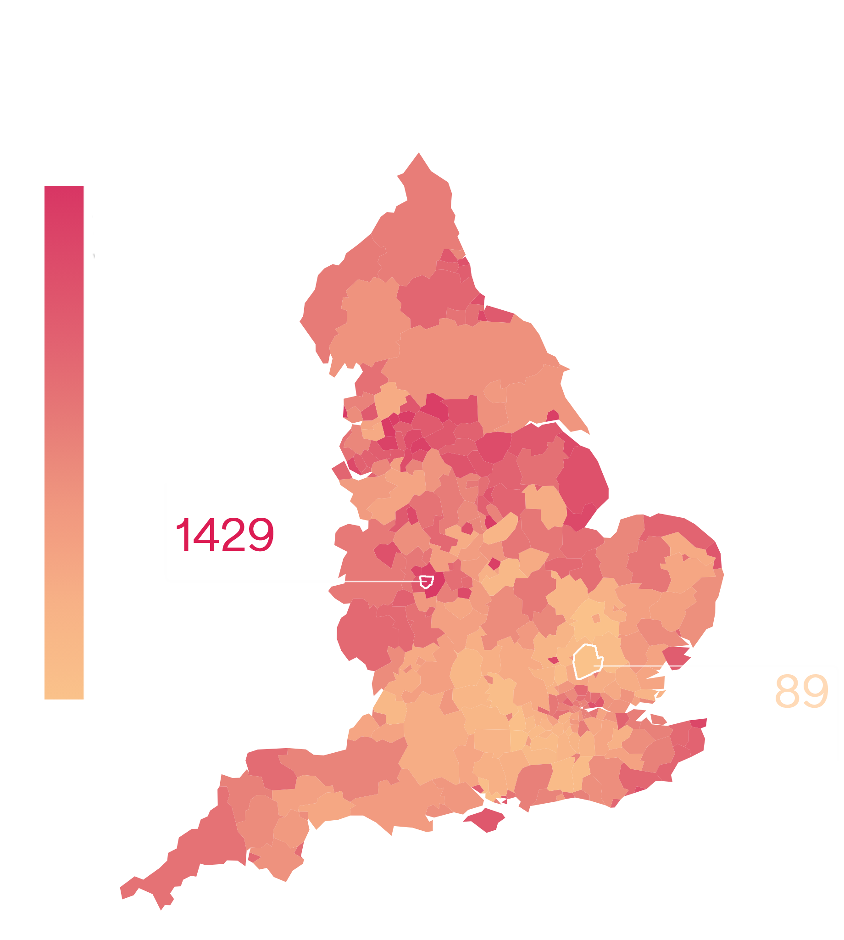
Key finding 1: Most vulnerable
The populations of Sandwell, Blackpool, Birmingham, Blackburn and Darwen and Nottingham are most vulnerable to the rising cost of living.
All five of these places are also ranked in the top decile of the Index of Multiple Deprivation, meaning that they suffer from a complex, interconnecting disadvantages.
Regionally, there are high concentrations of vulnerable places in the North West, West Midlands, and Yorkshire and the Humber.
The most vulnerable places haven’t changed much since 2022.
Five local authorities in our top decile (Leister, Thanet, Luton, Stoke-on-Trent, and Telford and Wrekin) are currently not on any devolution pathway, highlighting the potential for places to slip through the cracks if they aren’t integrated with a specific devolutionary path.
Source: GRN analysis of ONS, DEFRA, and the University of Loughborough data
Notes:
Even without food insecurity, the most vulnerable places remain similar to 2022.
Places like Thanet and Luton show a need for gov to engage directly with local councils.

Slide 4
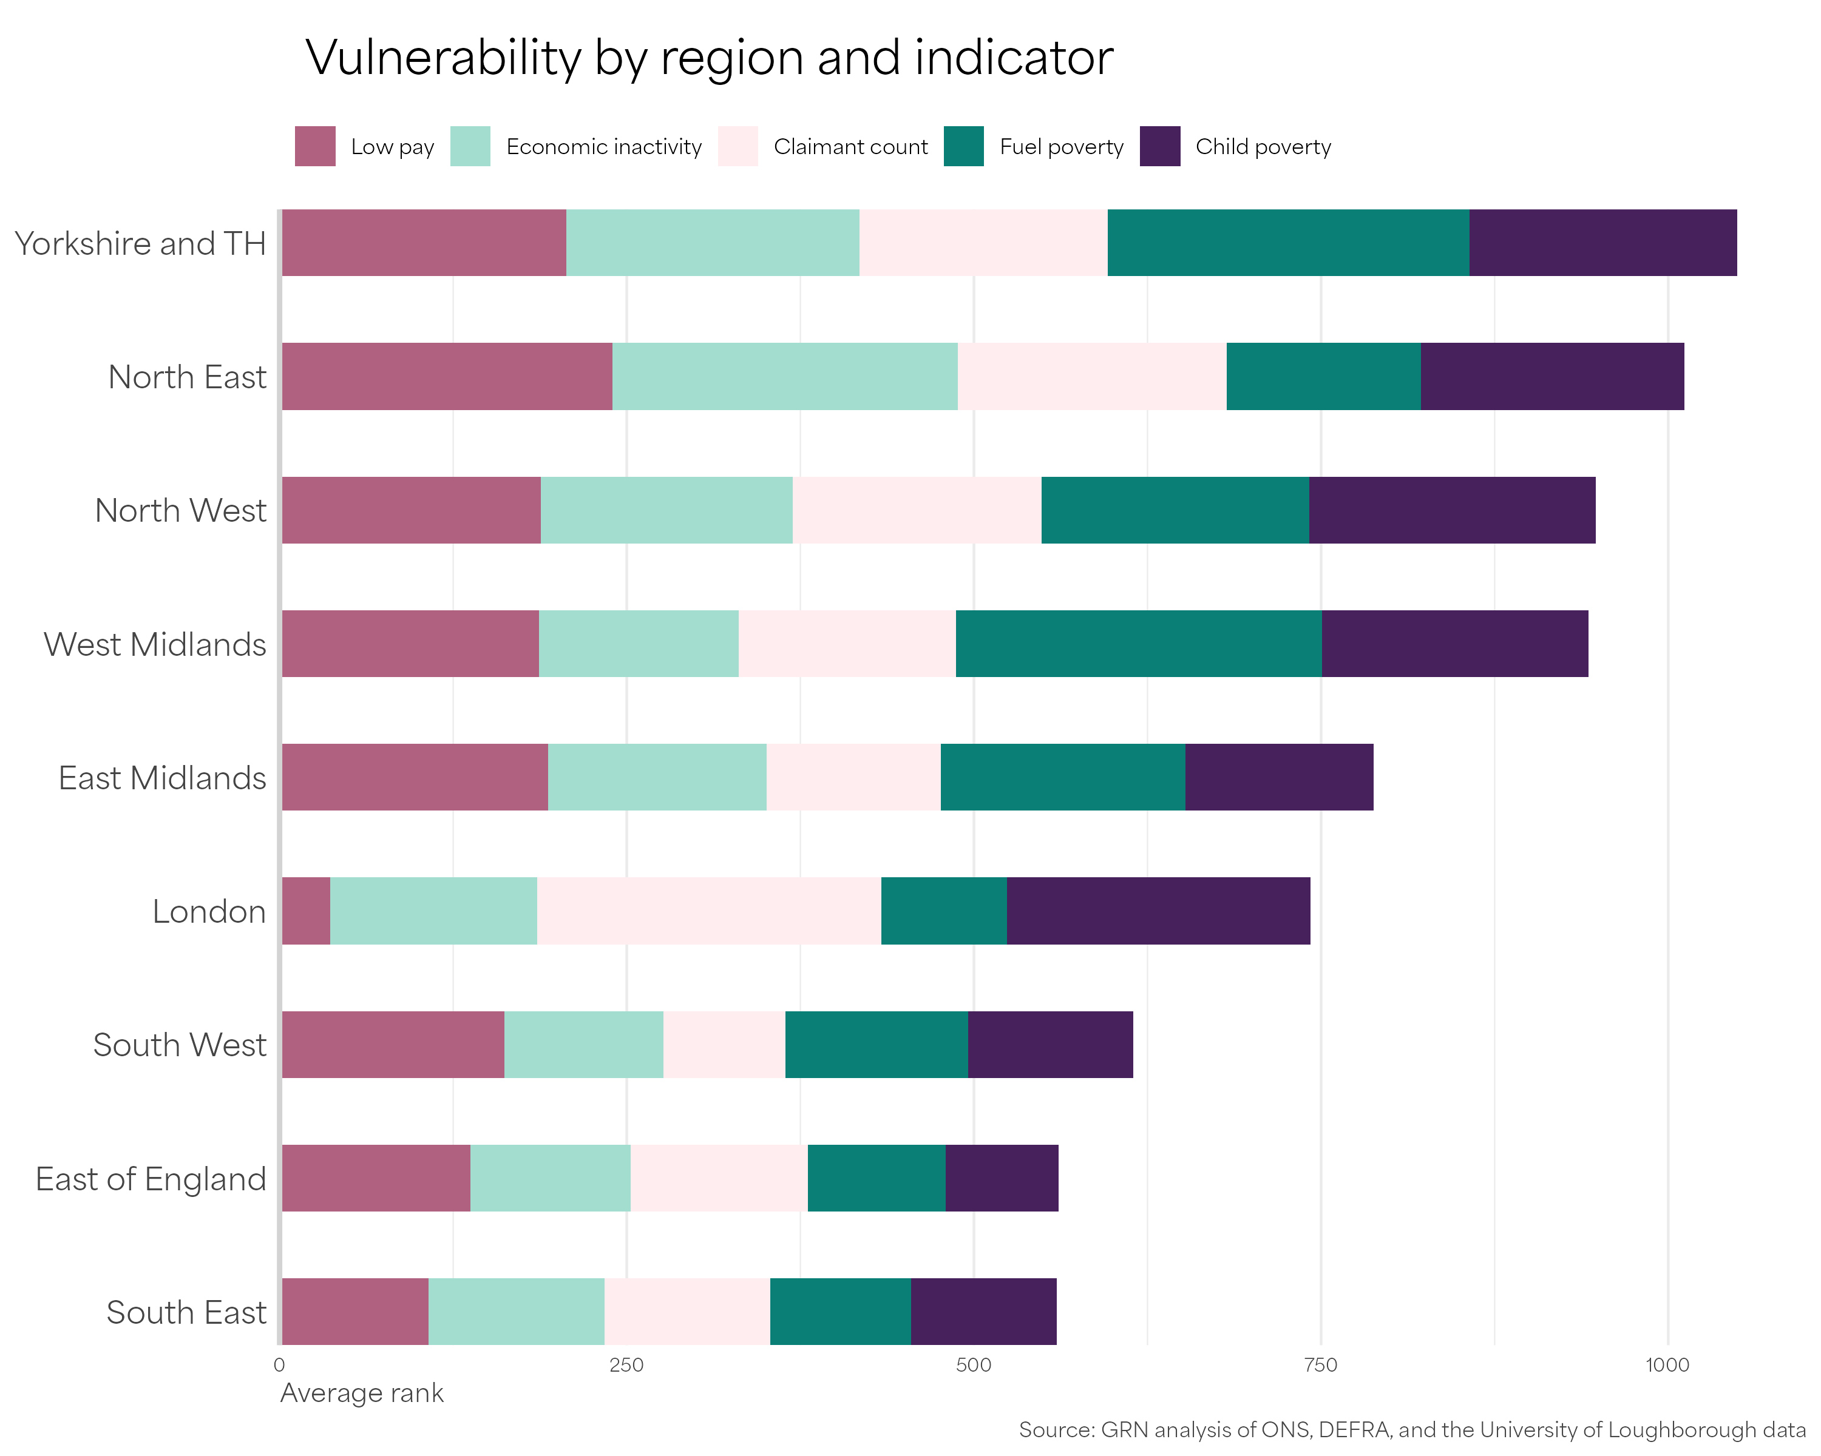

Slide 5
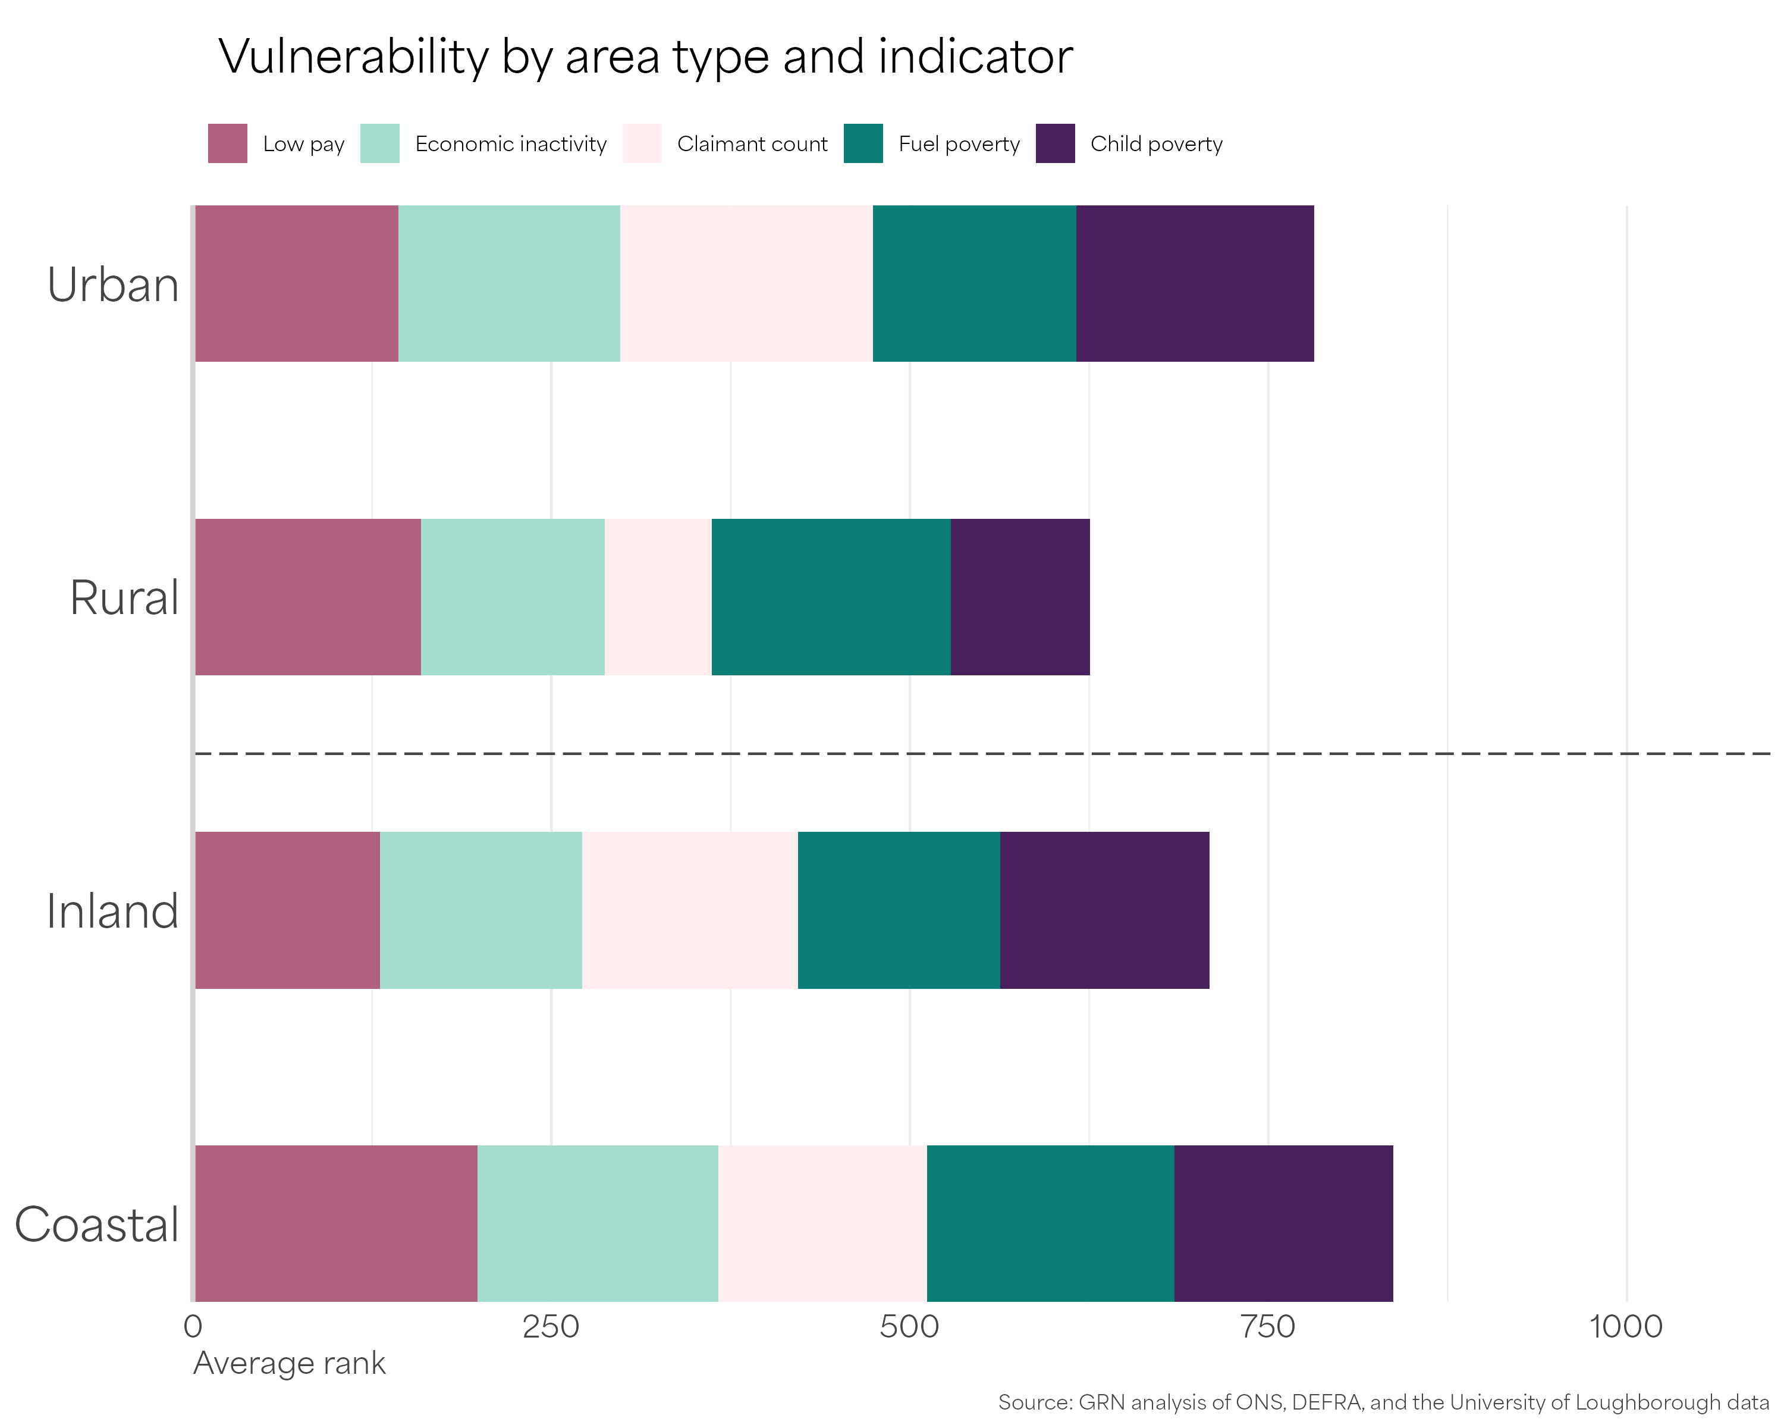
Key finding 2:
Coastal areas are more vulnerable
Coastal areas are more vulnerable, on average, than other area types. This was true in the previous Index.
The South East coast, including Thanet and Hastings, has become more vulnerable since the last Index.
Coastal areas are particularly vulnerable to combinations of low pay and economic inactivity.
Poor transport links and poor broadband coverage are major obstacles for these communities trying to move their economies away from hospitality.
Notes:
Loss of EU structural funds likely contributor.
Previous index found that rural vulnerability was linked to rising economic inactivity and rising number of low paying jobs.

Slide 6

Key finding 3:
Child poverty and claimant count are stable, while low pay and economic inactivity are volatile
In the three years between 2022 and 2025, the proportion of people claiming benefits and the proportion of children in poverty did not change that much.
Child poverty is entrenched in certain places and disconnected from improvements in pay and employment at the local authority and regional level.
On the other hand, levels of low pay and economic inactivity changed a lot with no clear regional pattern. Some neighbouring local authorities, such as North and Mid Devon, swung sharply in opposite directions.
Notes:
We know that child poverty is connected to pay and employment at the LSOA level, but our findings suggest that upper levels of growth do not necessarily trickle down. Important to ensure that policies are robust enough to reach the neighbourhood level.
Low pay/economic inactivity – We need to focus on resilience as well as growth.

Slide 7

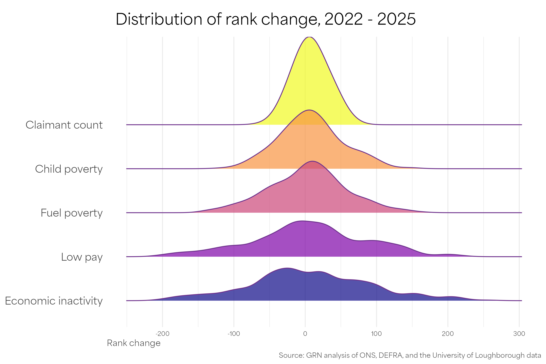
Key finding 3:
Child poverty and claimant count are stable, while low pay and economic inactivity are volatile
Notes:
Explain distribution: clustered around the centre means stable, spread out means more changes

Slide 8
Discussion
Do the findings line up with your experience of your area?
How can local and combined authorities can use neighbourhood-level interventions to affect benefit claimants and child poverty?
Why do you think the economic inactivity and low pay have been so volatile within places across time? How can we create resilient economies?
Notes:
Tailored cuts of the data are available upon request.

